Slide 1
Identification of argumentation acts
Berariu Tudor
Danciu Alin
Sorici Alexandru

Slide 2
Contents
Software architecture specification
Typical dataflow
Algorithms
Technologies

Slide 3
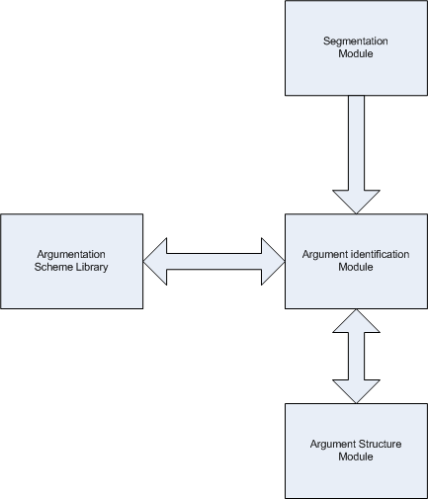
Software architecture specification

Slide 4
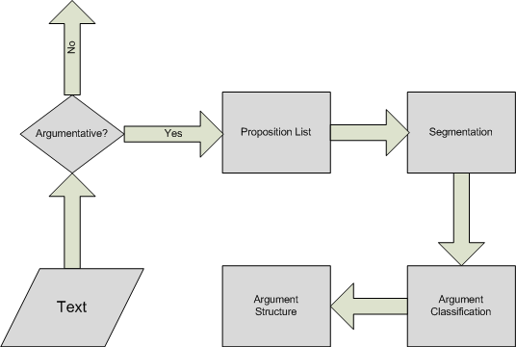
Process flow

Slide 5
Algorithms
Maximum Entropy and SVM classifier
Bayesian Classifier (with chosen features)
Learning algorithm (neural networks)

Slide 6
Algorithms
Features for argument identification
Adverbs (POS Tagger)
Verbs (POS Tagger)
Text statistics
Punctuation
Key words
Parse features

Slide 7
Algorithms
Argument segmentation:
Semantic distance (WordNet)
Similarity function based on the similarities between words

Slide 8
Algorithms
Argument classification(SVM):
Type of Subject (POS Tagger)
Type of Main Verb (POS Tagger)
Article reference
Key patterns
Absolute location

Slide 9
Technologies
Corpus used : Araucaria
Language : python and C
NLTK, Araucaria scheme library

Slide 10
Resources
Argumentation Mining: The Detection, Classification and
Structuring of Arguments in Text - Raquel Mochales Palau, Marie-Francine Moens
Study on the Structure of Argumentation in Case Law - Raquel Mochales Palau, Marie-Francine Moens
Creating an argumentation corpus: do theories apply to
real arguments? - Raquel Mochales Palau, Aagje Ieven
Argumentation in Artificial Intelligence – Iyad Rahwan, Gullermo R. Simari

